Slide 1
Dynamic Documents with JavaScript
Introduction
Positioning Elements
Moving Elements
Element Visibility
Changing Colors and Fonts
Dynamic Content
Stacking Elements
Locating the Mouse Cursor
Reacting to a Mouse Click
Slow Movement of Elements
Dragging and Dropping Elements

Slide 2
Dynamic Documents with JavaScript
Introduction
Dynamic HTML is not a new markup language. It is a collection of technologies that allows dynamic changes to documents defined with HTML.
Dynamic HTML document is one whose,
tag attributes, tag contents, or element style properties
can be changed after the document has been and is still being displayed by a browser.
properties can be changed by user interaction or the occurrence of a browser event.
Consider only W3C standard approaches.
Example will use DOM 0 event model – work for both IE6 and NS6.
Dynamic changes in a document achieved through JavaScript.
Scripts address the elements of the document using their DOM addresses.

Slide 3
Positioning Elements
Web site authors had little control over how HTML elements were arranged in documents.
lack of powerful and efficient element placement control ended when Cascading Style Sheets–Positioning (CSS-P) was released by the W3C in 1997.
CSS-P is completely supported by IE8, IE9 and FX3.
JavaScript to change the positioning style properties of the element.
The position property has three possible values: absolute, relative, and static.

Slide 4
Absolute Positioning
The absolute value for position is specified when the element is to be placed at a specific location in the document display without regard to the positions of other elements.
For example, if a paragraph of text is to appear 100 pixels from the left edge and 200 pixels from the top of the display window.
<p style = "position: absolute; left: 100px; top: 200px">
-- text -- </p>

Slide 5
<!DOCTYPE html>
<!-- absPos.html
Illustrates absolute positioning of elements
-->
<html lang = "en">
<head>
<title> Absolute positioning </title>
<meta charset = "utf-8" />
<style type = "text/css">
/* A style for a paragraph of text */
.regtext {font-family: Times; font-size: 1.2em; width: 500px}

Slide 6
/* A style for the text to be absolutely positioned */
.abstext
{
position: absolute; top: 25px; left: 25px;
font-family: Times; font-size: 1.9em;
font-style: italic; letter-spacing: 1em;
color: rgb(160,160,160); width: 450px
}
</style>
</head>
<body>

Slide 7
<p class = "regtext">
Apple is the common name for any tree of the genus Malus,
of the family Rosaceae. Apple trees grow in any of the
temperate areas of the world. Some apple blossoms are white,
but most have stripes or tints of rose. Some apple blossoms
are bright red. Apples have a firm and fleshy structure that
grows from the blossom. The colors of apples range from
green to very dark red. The wood of apple trees is fine
grained and hard. It is, therefore, good for furniture
construction. Apple trees have been grown for many
centuries. They are propagated by grafting because they
do not reproduce themselves.
<span class = "abstext">
APPLES ARE GOOD FOR YOU
</span> </p> </body> </html>

Slide 8
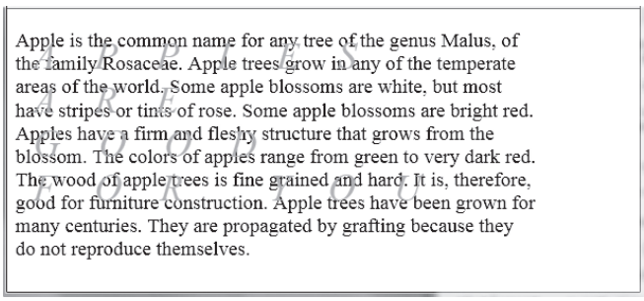
width property value is included in the style for both the regular and the special text.
This property is used here to ensure that the special text is uniformly embedded in the regular text.
text would extend to the right end of the browser display window—and, of course, the width of the window could vary widely from client to client and even from minute to minute on the same client because the user can resize the browser window at any time.

Slide 9
<!DOCTYPE html>
<!-- absPos2.html
Illustrates nested absolute positioning of elements
-->
<html lang = "en">
<head>
<title> Nested absolute positioning </title>
<meta charset = "utf-8" />
<style type = "text/css">
/* A style for a paragraph of text */
.regtext {font-family: Times; font-size: 1.2em; width: 500px;
position: absolute; top: 100px; left: 100px;}

Slide 10
/* A style for the text to be absolutely positioned */
.abstext {position: absolute; top: 25px; left: 25px;
font-family: Times; font-size: 1.9em;
font-style: italic; letter-spacing: 1em;
color: rgb(160,160,160); width: 450px;}
</style>
</head>
<body>
<p class = "regtext">
Apple is the common name for any tree of the genus Malus,
of the family Rosaceae. Apple trees grow in any of the
temperate areas of the world. Some apple blossoms are white

Slide 11
Apples have a firm and fleshy structure that
grows from the blossom. The colors of apples range from
green to very dark red. The wood of apple trees is fine
grained and hard. It is, therefore, good for furniture
construction. Apple trees have been grown for many
centuries. They are propagated by grafting because they
do not reproduce themselves.
<span class = "abstext">
APPLES ARE GOOD FOR YOU
</span>
</p>
</body>
</html>

Slide 12
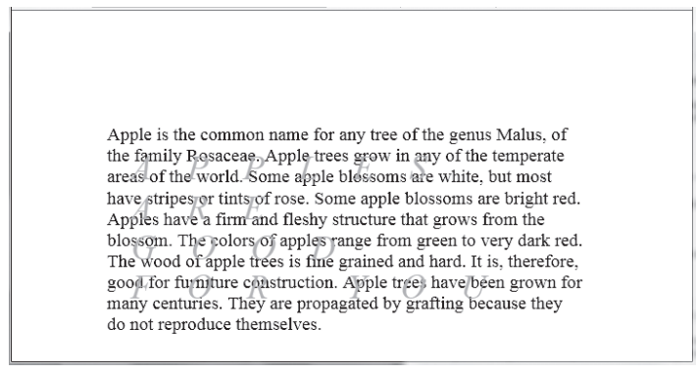
Relative Positioning
An element that has the position property set to relative, but does not specify top and left property values, is placed in the document as if the position attribute were not set at all.

Slide 13
top and left properties are given values, they displace the element by the specified amount from the position.
EXAMPLE
<!DOCTYPE html>
<!-- relPos.html
Illustrates relative positioning of elements
-->
<html lang = "en">
<head>
<title> Relative positioning </title>
<meta charset = "utf-8" />
<style type = "text/css">

Slide 14
.regtext {font: 2em Times}
.spectext {font: 2em Times; color: red; position: relative;
top: 15px;}
</style>
</head>
<body>
<p class = "regtext">
Apples are
<span class = "spectext"> GOOD </span> for you.
</p>
</body>
</html>

Slide 15
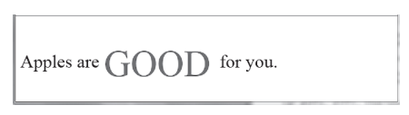
Static Positioning
The default value for the position property is static. A statically positioned element is placed in the document as if it had the position value of relative but no values for top or left were given.
The difference is that a statically positioned element cannot have its top or left properties initially set or changed later. Therefore, a statically placed element initially cannot be displaced from its normal position and cannot be moved from that position later.

Slide 16
Elements can be positioned at any given location in the display of the document if their position property is set to absolute or relative.
Absolute positioning uses the left and top properties of an element to place the element at a position relative to the upper-left corner of the display of the document.
Relative positioning is used to place an element at a specified offset from the top and left coordinates of where it would have gone with the default static positioning.
Relative positioning also allows an element to be moved later.

Slide 17
Moving Elements
HTML element whose position property is set to either absolute or relative can be moved.
Changing the top or left property values causes the element to move on the display.
If its position is set to absolute, the element moves to the new values of top and left; if its position is set to relative, it moves from its original position by distances given by the new values of top and left.
Static positioning, which is the default, disallows both specific initial placement and dynamic moving of the element.

Slide 18
<!DOCTYPE html>
<!-- mover.html
Uses mover.js to move an image within a document
-->
<html lang = "en">
<head>
<title> Moving elements </title>
<meta charset = "utf-8" />
<script type = "text/javascript" src = "mover.js" >
</script>
</head>
<body>
<form action = "">

Slide 19
<p>
<label>
x coordinate:
<input type = "text" id = "leftCoord" size = "3" />
</label>
<br />
<label>
y coordinate:
<input type = "text" id = "topCoord" size = "3" />
</label>
<br />

Slide 20
<input type = "button" value = "Move it"
onclick =
"moveIt('saturn',
document.getElementById('topCoord').value,
document.getElementById('leftCoord').value)" />
</p>
</form>
<div id = "saturn" style = "position: absolute;
top: 115px; left: 0;">
<img src = "../images/saturn.png"
alt = "(Picture of Saturn)" />
</div>
</body>
</html>

Slide 21
// mover.js
// Illustrates moving an element within a document
// The event handler function to move an element
function moveIt(movee, newTop, newLeft) {
dom = document.getElementById(movee).style;
// Change the top and left properties to perform the move
// Note the addition of units to the input values
dom.top = newTop + "px";
dom.left = newLeft + "px";
}

Slide 22
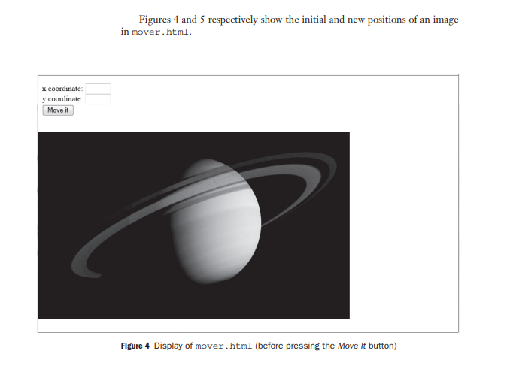

Slide 23
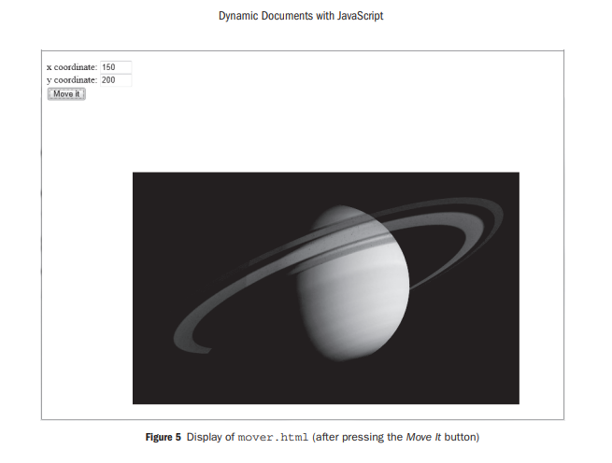

Slide 24
Element Visibility
Document elements can be specified to be visible or hidden with the value of their visibility property.
The two possible values for visibility are, quite naturally, visible and hidden.
The appearance or disappearance of an element can be controlled by the user through a widget.

Slide 25
<!DOCTYPE html>
<!-- showHide.html
Uses showHide.js
Illustrates visibility control of elements
-->
<html lang = "en">
<head>
<title> Visibility control </title>
<meta charset = "utf-8" />
<script type = "text/javascript" src = "showHide.js" >
</script>
</head>

Slide 26
<body>
<form action = "">
<div id = "saturn" style = "position: relative;
visibility: visible;">
<img src = "../images/saturn.png"
alt = "(Picture of Saturn)" />
</div>
<p>
<br />
<input type = "button" value = "Toggle Saturn"
onclick = "flipImag()" />
</p>

Slide 27
</form>
</body>
</html>
// showHide.js
// Illustrates visibility control of elements
// The event handler function to toggle the visibility
// of the images of Saturn
function flipImag() {
dom = document.getElementById("saturn").style;
// Flip the visibility adjective to whatever it is not now

Slide 28
if (dom.visibility == "visible")
dom.visibility = "hidden";
else
dom.visibility = "visible";
}

Slide 29
Changing Colors and Fonts
The background and foreground colors of the document display can be dynamically changed, as can the font properties of the text.
Changing Colors
Dynamic changes to colors are relatively simple. In the next example, the user is presented with two text boxes into which color specifications can be typed—one for the document background color and one for the foreground color. The colors can be specified in any of the three ways that color properties can be given in CSS.
Background color is controlled by the Background color property.
Foreground colors is controlled by the color property.

Slide 30
<!DOCTYPE html>
<!-- dynColors.html
Uses dynColors.js
Illustrates dynamic foreground and background colors
-->
<html lang = "en">
<head>
<title> Dynamic colors </title>
<meta charset = "utf-8" />
<script type = "text/javascript" src = "dynColors.js" >
</script>
</head>

Slide 31
<body>
<p style = "font-family: Times; font-style: italic;
font-size: 2em;" >
This small page illustrates dynamic setting of the
foreground and background colors for a document
</p>
<form action = "">
<p>
<label>
Background color:
<input type = "text" name = "background" size = "10"
onchange = "setColor('background', this.value)" />
</label>

Slide 32
<br />
<label>
Foreground color:
<input type = "text" name = "foreground" size = "10"
onchange = "setColor('foreground', this.value)" />
</label>
<br />
</p>
</form>
</body>
</html>

Slide 33
// dynColors.js
// Illustrates dynamic foreground and background colors
// The event handler function to dynamically set the
// color of background or foreground
function setColor(where, newColor) {
if (where == "background")
document.body.style.backgroundColor = newColor;
else
document.body.style.color = newColor;
}

Slide 34
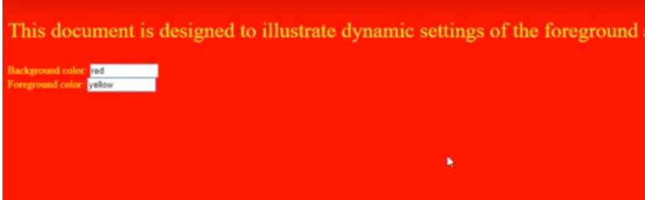
Set background and foreground color

Slide 35
Changing Fonts
Web users are accustomed to having links in documents change color when the cursor is placed over them.
Use of the mouseover event to trigger a JavaScript event handler allows us to change any property of any element in a document, including text, when the mouse cursor is placed over it.
Thus, the font style and font size, as well as the color and background color of text, can be changed when the cursor is placed over the text.
Change font properties of a link by using the mouseover and mouseout event to trigger a script that makes the changes.

Slide 36
The text can be changed back to its original form when an event handler is triggered with the mouseout event.
For CSS attribute names that are single words without hyphens, the associated JavaScript property names are the same as the attribute names. But when an attribute name includes a hyphen, as in font-size, the associated property name must be different.
The convention is that when an attribute name has a hyphen, the hyphen is deleted.
The letter that follows is capitalized in its associated property name. So, the property name associated with the attribute font-size is fontSize.

Slide 37
Example:
<!DOCTYPE html>
<!-- dynFont.html
Illustrates dynamic font styles and colors
-->
<html lang = "en">
<head>
<title> Dynamic fonts </title>
<meta charset = "utf-8" />

Slide 38
<style type = "text/css">
.regText {font: 1.1em 'Times New Roman';}
.wordText {color: blue;}
</style>
</head>
<body>
<p class = "regText">
The state of
<span class = "wordText";
onmouseover = "this.style.color = 'red';

Slide 39
this.style.fontStyle = 'italic';
this.style.fontSize = '2em';";
onmouseout = "this.style.color = 'blue';
this.style.fontStyle = 'normal';
this.style.fontSize = '1.1em';";>
Washington
</span>
The female incubates while the male bring her food.
</p>
</body>
</html>

Slide 40
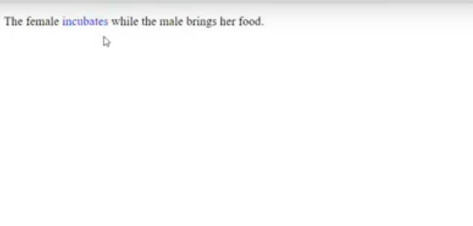

Slide 41
Dynamic Content
Explored the options of dynamically changing the positions of elements, their visibility, colors, background colors, and the styles of text fonts.
This section investigates changing the content of HTML elements. The content of an element is accessed through the value property of its associated JavaScript object.
Changing the content of an element is not essentially different from changing the style properties of the element.
Assistance to a browser user filling out a form can be provided with an associated text area often called a help box. The content of the help box can change, depending on the placement of the mouse cursor.
The content of an HTML element is addressed with the Value property of its associated JavaScript object.

Slide 42
Example
<!DOCTYPE html>
<!-- dynValue.html
Illustrates dynamic values
-->
<html lang = "en">
<head>
<title> Dynamic values </title>
<meta charset = "utf-8" />
<script type = "text/javascript" src = "dynValue.js" >
</script>
<style type = "text/css">

Slide 43
textarea {position: absolute; left: 250px; top: 0px;}
span {font-style: italic;}
p {font-weight: bold;}
</style>
</label>
<br />
<label>
Email:
<input type = "text" onmouseover = "messages(1)"
onmouseout = "messages(4)" />
</label>
<br /> <br />

Slide 44
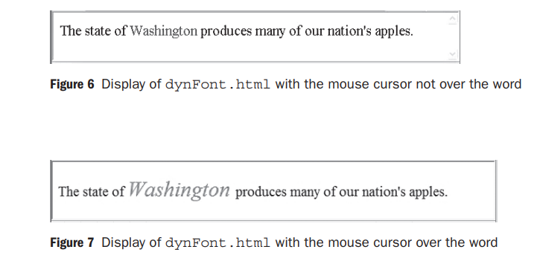

Slide 45
<span>
To create an account, provide the following:
</span>
<br /> <br />
<label>
User ID:
<input type = "text" onmouseover = "messages(2)"
onmouseout = "messages(4)" />
</label>
<br />

Slide 46
<label>
Password:
<input type = "password"
onmouseover = "messages(3)"
onmouseout = "messages(4)" />
</label>
<br />
</p>
<textarea id = "adviceBox" rows = "3" cols = "50">
This box provides advice on filling out the form
on this page. Put the mouse cursor over any input
field to get advice.
</textarea>

Slide 47
<br /><br />
<input type = "submit" value = "Submit" />
<input type = "reset" value = "Reset" />
</form>
</body>
</html>

Slide 48
// dynValue.js
// Illustrates dynamic values
var helpers = ["Your name must be in the form: \n \
first name, middle initial., last name",
"Your email address must have the form: \
user@domain",
"Your user ID must have at least six characters",
"Your password must have at least six \
characters and it must include one digit",
"This box provides advice on filling out\
the form on this page. Put the mouse cursor over any \
input field to get advice"]

Slide 49
// ***********************************************************
// The event handler function to change the value of the
// textarea
function messages(adviceNumber) {
document.getElementById("adviceBox").value =
helpers[adviceNumber];
}

Slide 50
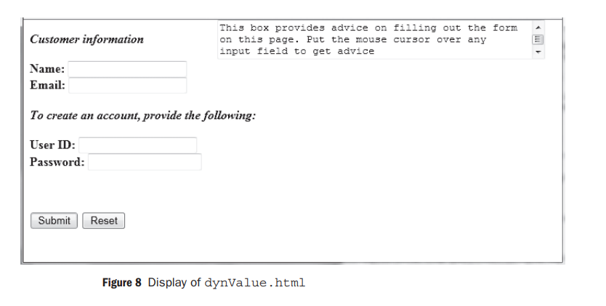

Slide 51
Stacking Elements
The top and left properties allow the placement of an element anywhere in the two dimensions of the display of a document.
Although the display is restricted to two physical dimensions, the effect of a third dimension is possible through the simple concept of stacked elements, such as that used to stack windows in graphical user interfaces.
Although multiple elements can occupy the same space in the document, one is considered to be on top and is displayed. The top element hides the parts of the lower elements on which it is superimposed.
The placement of elements in this third dimension is controlled by the z-index attribute of the element.

Slide 52
An element whose z-index is greater than that of an element in the same space will be displayed over the other element, effectively hiding the element with the smaller z-index value.
The JavaScript style property associated with the z-index attribute is z-Index.
The top and left property determine the position of an element on the display screen, which is a two dimensional device.
Create the appearance of a third dimensional by having overlapping elements.
Done with the z-index property which cover by the front element.
Dynamic changes done in when mouse click.

Slide 53
<!DOCTYPE html>
<!-- stacking.html
Uses stacking.js
Illustrates dynamic stacking of images.
-->
<html lang = "en">
<head>
<title> Dynamic stacking of images </title>
<meta charset = "utf-8" />
<script type = "text/javascript" src = "stacking.js" >
</script>

Slide 54
<style type = "text/css">
.plane1 {position: absolute; top: 0; left: 0;
z-index: 0;}
.plane2 {position: absolute; top: 50px; left: 110px;
z-index: 0;}
.plane3 {position: absolute; top: 100px; left: 220px;
z-index: 0;}
</style>
</head>

Slide 55
<body>
<p>
<img class = "plane1" id = "airplane1"
src = "../images/airplane1.png"
alt = "(Picture of an airplane)"
onclick = "toTop('airplane1')" />
<img class = "plane2" id = "airplane2"
src = "../images/airplane2.png"
alt = "(Picture of an airplane)"
onclick = "toTop('airplane2')" />
<img class = "plane3" id = "airplane3"
src = "../images/airplane3.png"

Slide 56
alt = "(Picture of an airplane)"
onclick = "toTop('airplane3')" />
</p>
</body>
</html>

Slide 57
// stacking.js
// Illustrates dynamic stacking of images
var topp = "airplane1";
// The event handler function to move the given element
// to the top of the display stack
function toTop(newTop) {
// Set the two dom addresses, one for the old top
// element and one for the new top element
domTop = document.getElementById(topp).style;
domNew = document.getElementById(newTop).style;
// Set the zIndex properties of the two elements, and
// reset topp to the new top

Slide 58
domTop.zIndex = "0";
domNew.zIndex = "10";
topp = newTop;
}

Slide 59
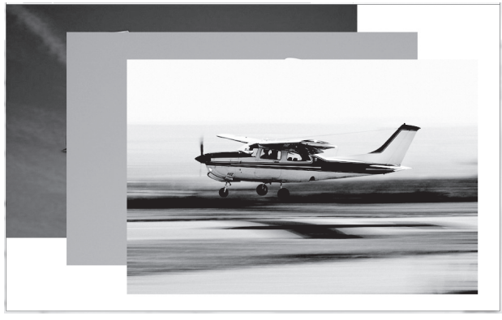

Slide 60
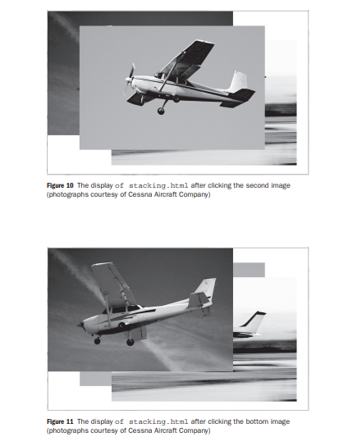

Slide 61
Locating the Mouse Cursor:
Every event that occurs while an HTML document is being displayed creates an event object.
This object includes some information about the event. A mouse click event is an implementation of the Mouse-Event interface, which defines two pairs of properties that provide geometric coordinates of the position of the element in the display that created the event.
One of these pairs, clientX and clientY, gives the coordinates of the element relative to the upper-left corner of the browser display window, in pixels.
ClientX and clientY property.
When mouseclick the corresponding coordinate will displayed, using click event.

Slide 62
The other pair, screenX and screenY, also gives coordinates of the element, but relative to the client computer’s screen.
example:
<!DOCTYPE html>
<!-- where.html
Uses where.js
Illustrates x- and y-coordinates of the mouse cursor
-->
<html lang = "en">

Slide 63
<head>
<title> Where is the cursor? </title>
<meta charset = "utf-8" />
<script type = "text/javascript" src = "where.js" >
</script>
</head>
<body onclick = "findIt(event)">
<form action = "">

Slide 64
<p>
Within the client area: <br />
x:
<input type = "text" id = "xcoor1" size = "4" />
y:
<input type = "text" id = "ycoor1" size = "4" />
<br /><br />
Relative to the origin of the screen coordinate system:
<br />
x:
<input type = "text" id = "xcoor2" size = "4" />
y:

Slide 65
<input type = "text" id = "ycoor2" size = "4" />
</p>
</form>
<p>
<img src = "../images/airplane1.png" alt = "(Picture of an
airplane)" />
</p>
</body>
</html>

Slide 66
// where.js
// Show the coordinates of the mouse cursor position
// in an image and anywhere on the screen when the mouse
// is clicked
// The event handler function to get and display the
// coordinates of the cursor, both in an element and
// on the screen
function findIt(evt) {
document.getElementById("xcoor1").value = evt.clientX;
document.getElementById("ycoor1").value = evt.clientY;
document.getElementById("xcoor2").value = evt.screenX;
document.getElementById("ycoor2").value = evt.screenY;
}

Slide 67
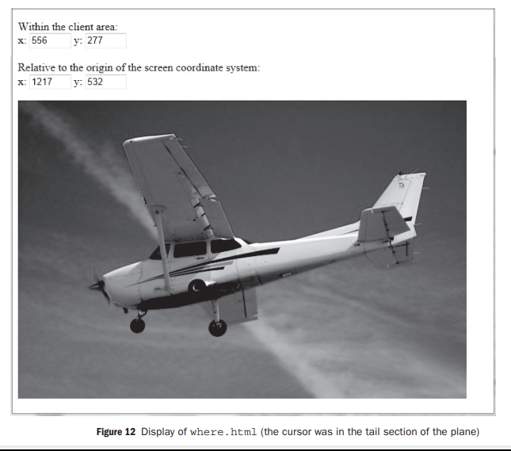

Slide 68
Reacting to a Mouse Click
The next example is another one related to reacting to mouse clicks. In this case, the mousedown and mouseup events are used, respectively, to show and hide the message “Please don’t click here!” on the display under the mouse cursor when ever the mouse button is clicked, regardless of where the cursor is at the time.
The offsets (-130 for left and -25 for top) modify the actual cursor position.
A mouse click can be used to trigger an action.
Use event handlers for onmousedown and onmouseup that change the visibility attributes of the message.

Slide 69
<!DOCTYPE html>
<!-- anywhere.html
Uses anywhere.js
Display a message when the mouse button is pressed,
no matter where it is on the screen
-->
<html lang = "en">
<head>
<title> Sense events anywhere </title>
<meta charset = "utf-8" />
<script type = "text/javascript" src = "anywhere.js" >
</script>

Slide 70
</head>
<body onmousedown = "displayIt(event);"
onmouseup = "hideIt();">
<p>
<span id= "message"
style = "color: red; visibility: hidden;
position: relative;
font-size: 1.7em; font-style: italic;
font-weight: bold;">
Please don't click here!
</span>
<br /><br /><br /><br /><br /><br /><br /><br />

Slide 71
<br /><br /><br /><br /><br /><br /><br /><br />
</p>
</body>
</html>

Slide 72
// anywhere.js
// Display a message when the mouse button is pressed,
// no matter where it is on the screen
// The event handler function to display the message
function displayIt(evt) {
var dom = document.getElementById("message");
dom.style.left = (evt.clientX - 130) + "px";
dom.style.top = (evt.clientY - 25) + "px";
dom.style.visibility = "visible";
}

Slide 73
// ****************************************************
// The event handler function to hide the message
function hideIt() {
document.getElementById("message").style.visibility =
"hidden";
}

Slide 74
Slow Movement of Element
These movements are controlled by changing the top and left properties of the element to be moved. The only way to move an element slowly is to move it by small amounts many times, with the moves separated by small amounts of time.
JavaScript has two Window methods that are capable of this task: setTimeoutand setInterval.
The setTimeout method takes two parameters: a string of JavaScript code to be executed and a number of milliseconds of delay before executing the given code. For example, the call causes a 20-millisecond delay, after which the function mover is called.
setTimeout("mover()", 20);

Slide 75
The setInterval method has two forms. One form takes two parameters, exactly as does setTimeout. It executes the given code repeatedly, using the second parameter as the interval, in milliseconds, between executions.
The second form of setInterval takes a variable number of parameters.
The first parameter is the name of a function to be called, the second is the interval in milliseconds between the calls to the function, and the remaining parameters are used as actual parameters to the function being called.
To animate an element, it must be moved by small amount, many times, in rapid successor.
Set Timeout and onload

Slide 76
<!DOCTYPE html>
<!-- moveText.html
Uses moveText.js
Illustrates a moving text element
-->
<html lang = "en">
<head>
<title> Moving text </title>
<meta charset = "utf-8" />
<script type = "text/javascript"
src = "moveText.js">
</script>

Slide 77
</head>
<!-- Call the initializing function on load, giving the
destination coordinates for the text to be moved
-->
<body onload = "initText()">
<!-- The text to be moved, including its initial position -->
<p>
<span id = 'theText' style =
"position: absolute; left: 100px; top: 100px;
font: bold 1.7em 'Times Roman';
color: blue;"> Jump in the lake!

Slide 78
</span>
</p>
</body>
</html>
//***********************************************************
// This is moveText.js - used with moveText.html
var dom, x, y, finalx = 300, finaly = 300;
// ************************************************* //

Slide 79
// A function to initialize the x- and y-coordinates
// of the current position of the text to be moved
// and then call the mover function
function initText() {
dom = document.getElementById('theText').style;
/* Get the current position of the text */
var x = dom.left;
var y = dom.top;
/* Convert the string values of left and top to
numbers by stripping off the units */
x = x.match(/\d+/);
y = y.match(/\d+/);

Slide 80
/* Call the function that moves it */
moveText(x, y);
} /*** end of function initText */
// ************************************************* //
// A function to move the text from its original
// position to (finalx, finaly)
function moveText(x, y) {

Slide 81
/* If the x-coordinates are not equal, move
x toward finalx */
if (x != finalx)
if (x > finalx) x--;
else if (x < finalx) x++;
/* If the y-coordinates are not equal, move
y toward finaly */
if (y != finaly)
if (y > finaly) y--;
else if (y < finaly) y++;

Slide 82
/* As long as the text is not at the destination,
call the mover with the current position */
if ((x != finalx) || (y != finaly)) {
/* Put the units back on the coordinates before
assigning them to the properties to cause the
move */
dom.left = x + "px";
dom.top = y + "px";
/* Recursive call, after a 1-millisecond delay */
setTimeout("moveText(" + x + "," + y + ")", 1);
}
} /*** end of function moveText */

Slide 83
Dragging and Dropping Elements
One of the more powerful effects of event handling is allowing the user to drag and drop elements around the display screen. The mouseup, mousedown, and mouse move events can be used to implement this feature.
To illustrate drag and drop, an HTML document and a JavaScript file that creates a magnetic poetry system is developed, showing two static lines of a poem and allowing the user to create the last two lines from a collection of movable words.

Slide 84
<!DOCTYPE html>
<!-- dragNDrop.html
An example to illustrate the DOM 2 Event model
Allows the user to drag and drop words to complete
a short poem.
Does not work with IE browsers before IE9
-->
<html lang = "en">
<head>
<title> Drag and drop </title>
<meta charset = "utf-8" />
<script type = "text/javascript" src = "dragNdrop.js" >
</script>

Slide 85
</head>
<body style = "font-size: 20;">
<p>
Roses are red <br />
Violets are blue <br />
<span style = "position: absolute; top: 200px; left: 0px;
background-color: lightgrey;"
onmousedown = "grabber(event);"> candy </span>
<span style = "position: absolute; top: 200px; left: 75px;
background-color: lightgrey;"
onmousedown = "grabber(event);"> cats </span>

Slide 86
<span style = "position: absolute; top: 200px; left: 150px;
background-color: lightgrey;"
onmousedown = "grabber(event);"> cows </span>
<span style = "position: absolute; top: 200px; left: 225px;
background-color: lightgrey;"
onmousedown = "grabber(event);"> glue </span>
<span style = "position: absolute; top: 200px; left: 300px;
background-color: lightgrey;"
onmousedown = "grabber(event);"> is </span>
<span style = "position: absolute; top: 200px; left: 375px;
background-color: lightgrey;"
onmousedown = "grabber(event);"> is </span>
<span style = "position: absolute; top: 200px; left: 450px;
background-color: lightgrey;"
onmousedown = "grabber(event);"> meow </span>

Slide 87
<span style = "position: absolute; top: 250px; left: 0px;
background-color: lightgrey;"
onmousedown = "grabber(event);"> mine </span>
<span style = "position: absolute; top: 250px; left: 75px;
background-color: lightgrey;"
onmousedown = "grabber(event);"> moo </span>
<span style = "position: absolute; top: 250px; left: 150px;
background-color: lightgrey;"
onmousedown = "grabber(event);"> new </span>
<span style = "position: absolute; top: 250px; left: 225px;
background-color: lightgrey;"
onmousedown = "grabber(event);"> old </span>
<span style = "position: absolute; top: 250px; left: 300px;
background-color: lightgrey;"
onmousedown = "grabber(event);"> say </span>

Slide 88
<span style = "position: absolute; top: 250px; left: 375px;
background-color: lightgrey;"
onmousedown = "grabber(event);"> say </span>
<span style = "position: absolute; top: 250px; left: 450px;
background-color: lightgrey;"
onmousedown = "grabber(event);"> so </span>
<span style = "position: absolute; top: 300px; left: 0px;
background-color: lightgrey;"
onmousedown = "grabber(event);"> sticky </span>
<span style = "position: absolute; top: 300px; left: 75px;
background-color: lightgrey;"
onmousedown = "grabber(event);"> sweet </span>
<span style = "position: absolute; top: 300px; left: 150px;
background-color: lightgrey;"
onmousedown = "grabber(event);"> syrup </span>

Slide 89
<span style = "position: absolute; top: 300px; left: 225px;
background-color: lightgrey;"
onmousedown = "grabber(event);"> too </span>
<span style = "position: absolute; top: 300px; left: 300px;
background-color: lightgrey;"
onmousedown = "grabber(event);"> yours </span>
</p>
</body>
</html>

Slide 90
// dragNDrop.js
// An example to illustrate the DOM 2 Event model
// Allows the user to drag and drop words to complete
// a short poem.
// Does not work with IE browsers before IE9
// Define variables for the values computed by
// the grabber event handler but needed by mover
// event handler
var diffX, diffY, theElement;
// *******************************************************
// The event handler function for grabbing the word
function grabber(event) {

Slide 91
// Set the global variable for the element to be moved
theElement = event.currentTarget;
// Determine the position of the word to be grabbed,
// first removing the units from left and top
var posX = parseInt(theElement.style.left);
var posY = parseInt(theElement.style.top);
// Compute the difference between where it is and
// where the mouse click occurred
diffX = event.clientX - posX;
diffY = event.clientY - posY;
// Now register the event handlers for moving and
// dropping the word
document.addEventListener("mousemove", mover, true);
document.addEventListener("mouseup", dropper, true);

Slide 92
// Stop propagation of the event and stop any default
// browser action
event.stopPropagation();
event.preventDefault();
} //** end of grabber
// *******************************************************
// The event handler function for moving the word
function mover(event) {
// Compute the new position, add the units, and move the word
theElement.style.left = (event.clientX - diffX) + "px";
theElement.style.top = (event.clientY - diffY) + "px";

Slide 93
// Prevent propagation of the event
event.stopPropagation();
} //** end of mover
// *********************************************************
// The event handler function for dropping the word
function dropper(event) {
// Unregister the event handlers for mouseup and mousemove
document.removeEventListener("mouseup", dropper, true);
document.removeEventListener("mousemove", mover, true);
// Prevent propagation of the event
event.stopPropagation();
} //** end of dropper

Slide 94
